Slide 1

Used Car Market Analysis Using Web Scraping and EDA

Slide 2

ABOUT ME
Name : Akshay
Background :
BCOM CA(2023)
Any work experience: No
LinkedIn: https://www.linkedin.com/in/akshay-enugula-145193286/

Slide 3

PROBLEM STATEMENT
Used Car Market Analysis
Understanding the key factors influencing used car pricing and popularity by analyzing brand trends, fuel types, mileage, car age, and location. This study aims to uncover economic, usage-based, and brand-driven patterns that shape consumer preferences and resale value in the used car market, providing actionable insights for buyers, sellers, dealerships, and automotive platforms.

Slide 4

OBJECTIVE OF THE PROJECT
This project aims to analyze trends and patterns in the Indian used car market using data-driven insights. The study focuses on key factors such as car pricing, mileage, manufacturing year, brand value, fuel type, and location. By leveraging web scraping, exploratory data analysis, and statistical visualization, the project provides valuable business insights for car buyers, sellers, dealerships, and online platforms to optimize pricing strategies, inventory decisions, and customer targeting.

Slide 5
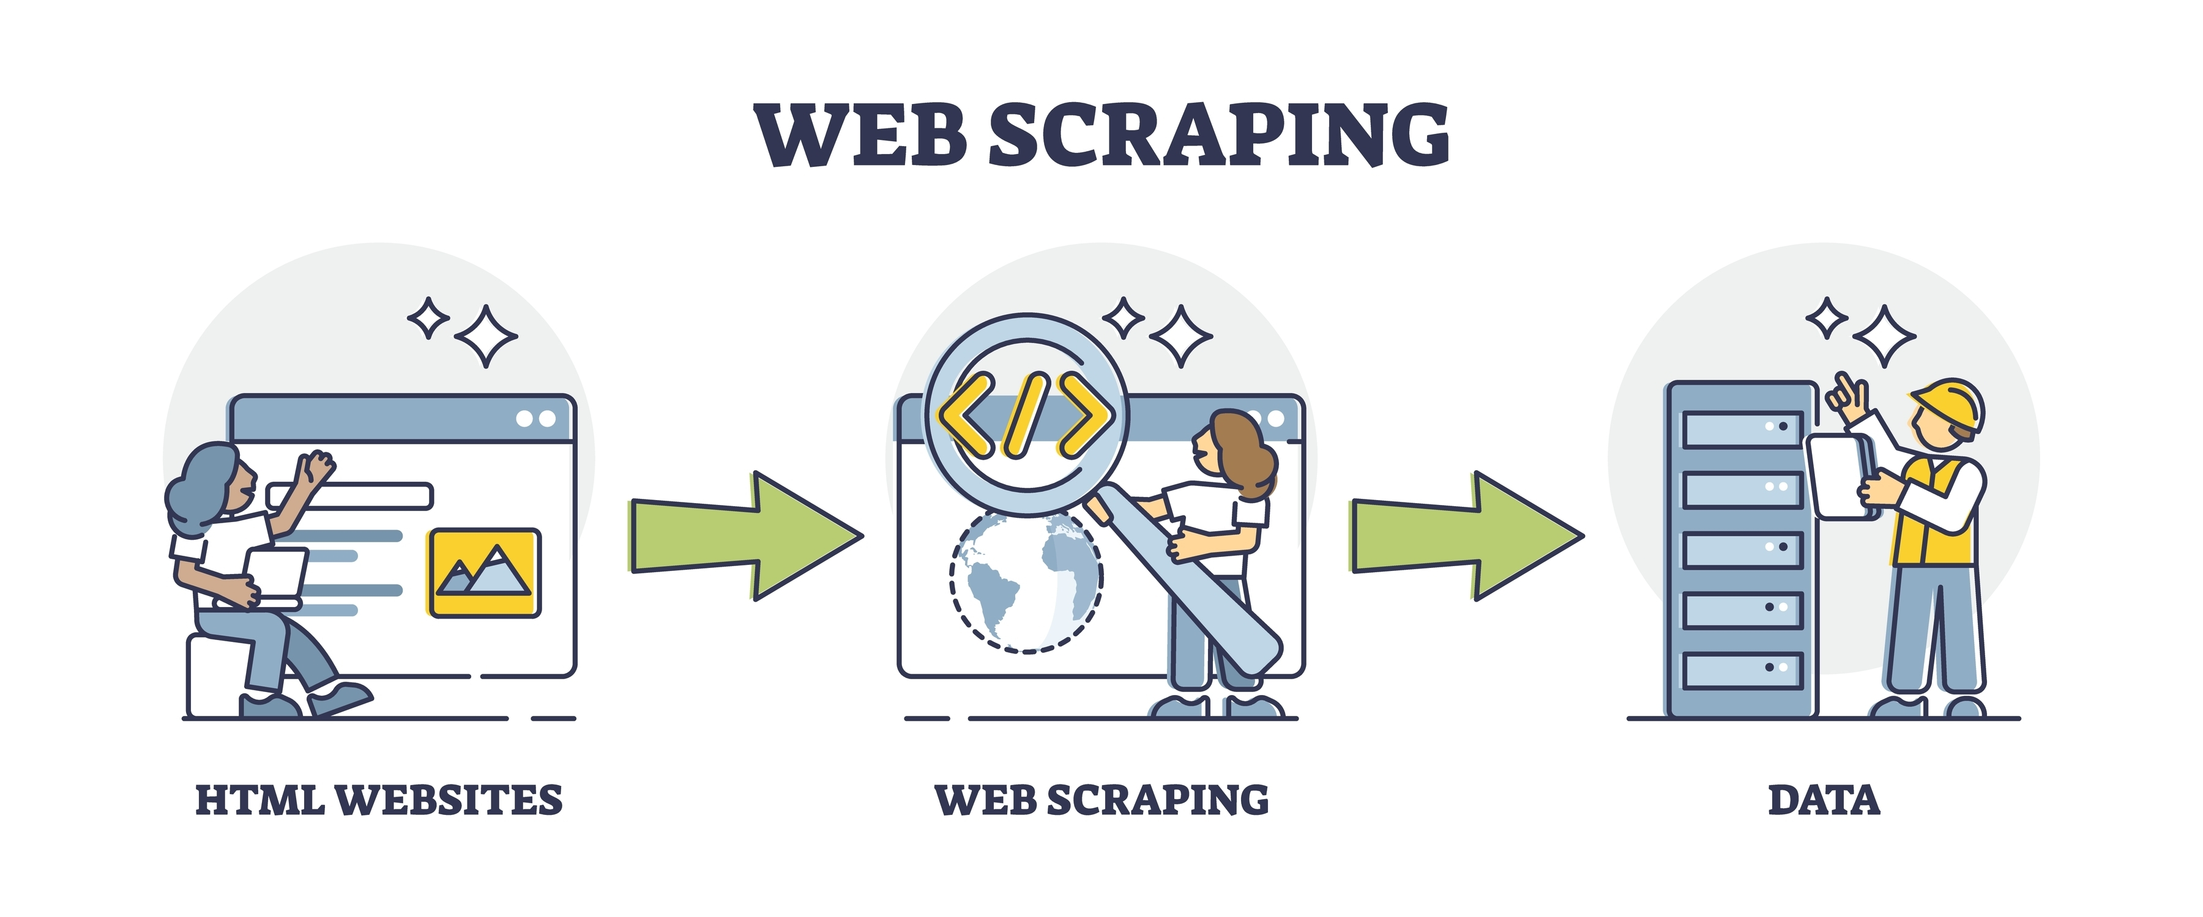
WEB SCRAPING DETAILS
Websites Used: https://www.carwale.com/used/hyderabad/
Data Cleaning : Pandas
Web Scraping Tools : Selenium, Beautiful Soup

Slide 6
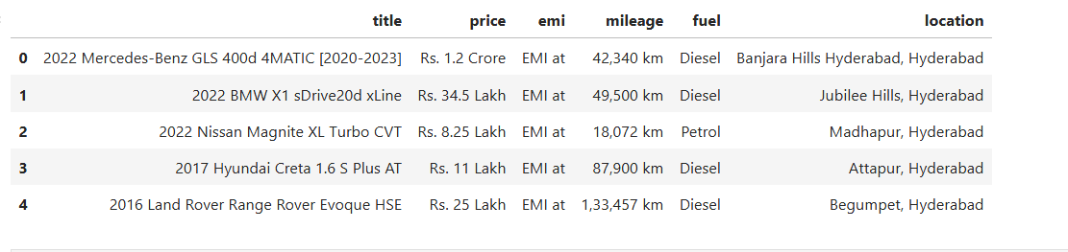

Slide 7
SUMMARY OF THE PROJECT
The dataset contains various attributes related to used cars, such as:
Brand – The make/manufacturer of the car (e.g., Maruti, Hyundai, Honda)
Model – Specific model name under the brand (e.g., Swift, i20, City)
Price – Listed price of the used car (in lakhs or thousands)
Year – Manufacturing year of the vehicle
Kilometers Driven – Total distance driven by the car (in km)
Fuel Type – Type of fuel used (e.g., Petrol, Diesel, CNG, Electric)
Owner Type – Number of previous owners (First, Second, etc.)
Mileage – Average mileage the car offers (e.g., 18 kmpl)
Transmission – Gear type of the car (Manual or Automatic)
Location – City or region where the car is listed
Engine – Engine capacity (e.g., 1197 CC)
Car Type – Body type (e.g., SUV, Sedan, Hatchback)
Insurance Status – Whether insurance is available or not
Registration Year – Year the vehicle was registered officially
Color – Exterior color of the vehicle

Slide 8
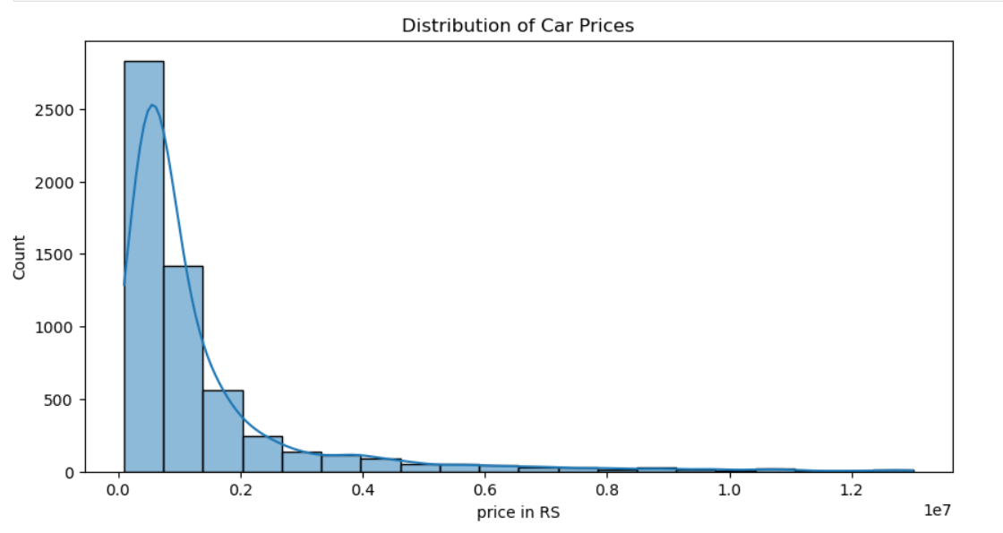
Analysis of Car Price Distribution
ANALYSIS
Used car platforms and dealers should focus their inventory on cars priced below ₹5 lakhs, as this segment dominates buyer demand. Affordable pricing drives the bulk of market activity, indicating strong interest from budget-conscious consumers. Luxury or high-end vehicles represent a niche segment with low volume but potentially higher margins. Pricing strategies and marketing efforts should be tailored accordingly to match the demand curve and optimize sales conversions.

Slide 9
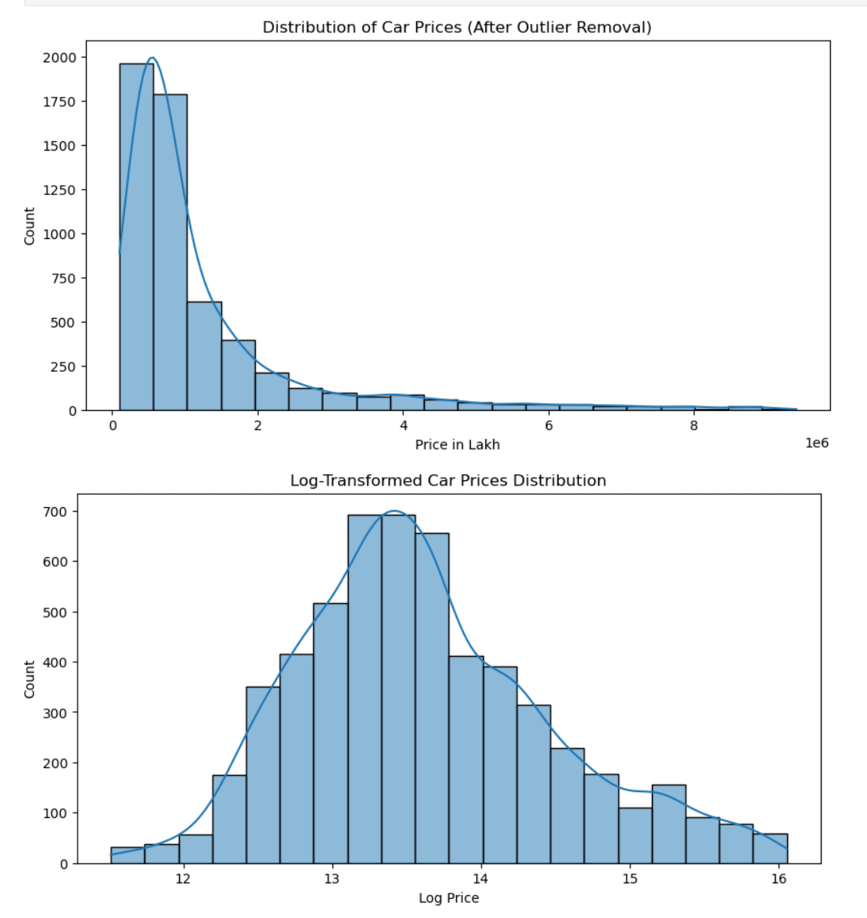
Car Price Distribution Analysis: Outlier Removal and Log Transformation
ANALYSIS
Outlier removal significantly improves the clarity of car price distribution, highlighting that most used cars are priced within ₹0–₹20 lakhs. The log transformation further normalizes this skewed data, resulting in a near-normal distribution that enhances the effectiveness of statistical modeling. This transformation is especially useful for predictive modeling, allowing for better insights into pricing trends and helping platforms apply regression techniques more reliably.

Slide 10
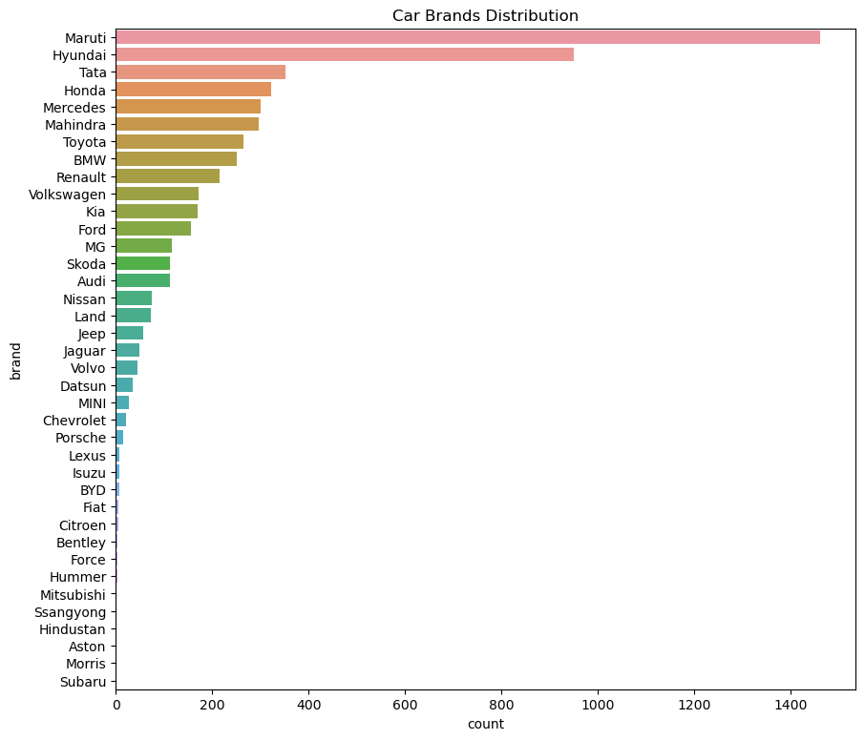
Analysis of the Car Brands Distribution Chart:
Analysis
The "Car Brands Distribution" chart reveals a highly concentrated market, with Maruti dominating significantly, followed by Hyundai, Tata, and Honda as strong second-tier players. A long tail of numerous other brands represents a much smaller share, indicating a competitive landscape where a few major brands hold the majority of the market. This distribution is typical of the Indian automotive market, where Maruti Suzuki consistently leads.

Slide 11
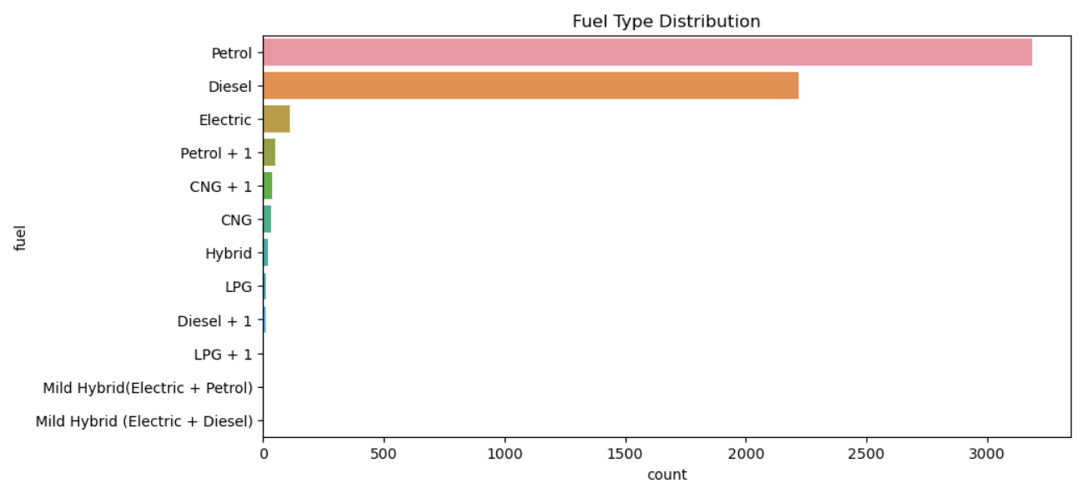
Fuel Type Distribution
ANALYSIS:
Petrol and Diesel are the dominant fuel types, significantly outnumbering all other options. Electric vehicles have a very minor presence, and other alternative fuels like CNG and various hybrids are almost negligible, indicating a strong preference for traditional fuel vehicles in the dataset..

Slide 12
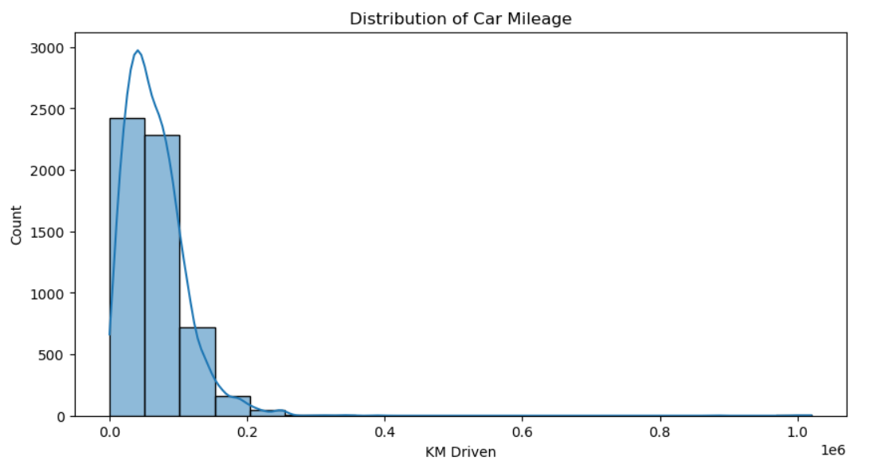
Analysis of Car Mileage Distribution:
ANALYSIS
This histogram illustrates that the vast majority of cars have a relatively low mileage (KM Driven), clustered heavily towards 0 KM. As the mileage increases, the number of cars rapidly decreases, indicating that fewer cars have very high mileage. The distribution is strongly right-skewed, with a long tail extending towards higher kilometers, though these high-mileage vehicles are very rare.

Slide 13
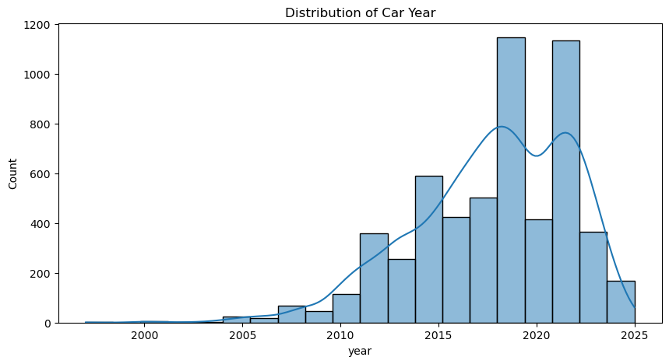
Distribution of Car Year
ANALYSIS
The graph shows a clear trend of increasing car production or availability over time, with a sharp rise from around 2010. There are two prominent peaks in car year distribution, one around 2019 and another around 2022, suggesting these were periods of high car sales or registration. Older cars (pre-2010) are far less numerous in this dataset.

Slide 14
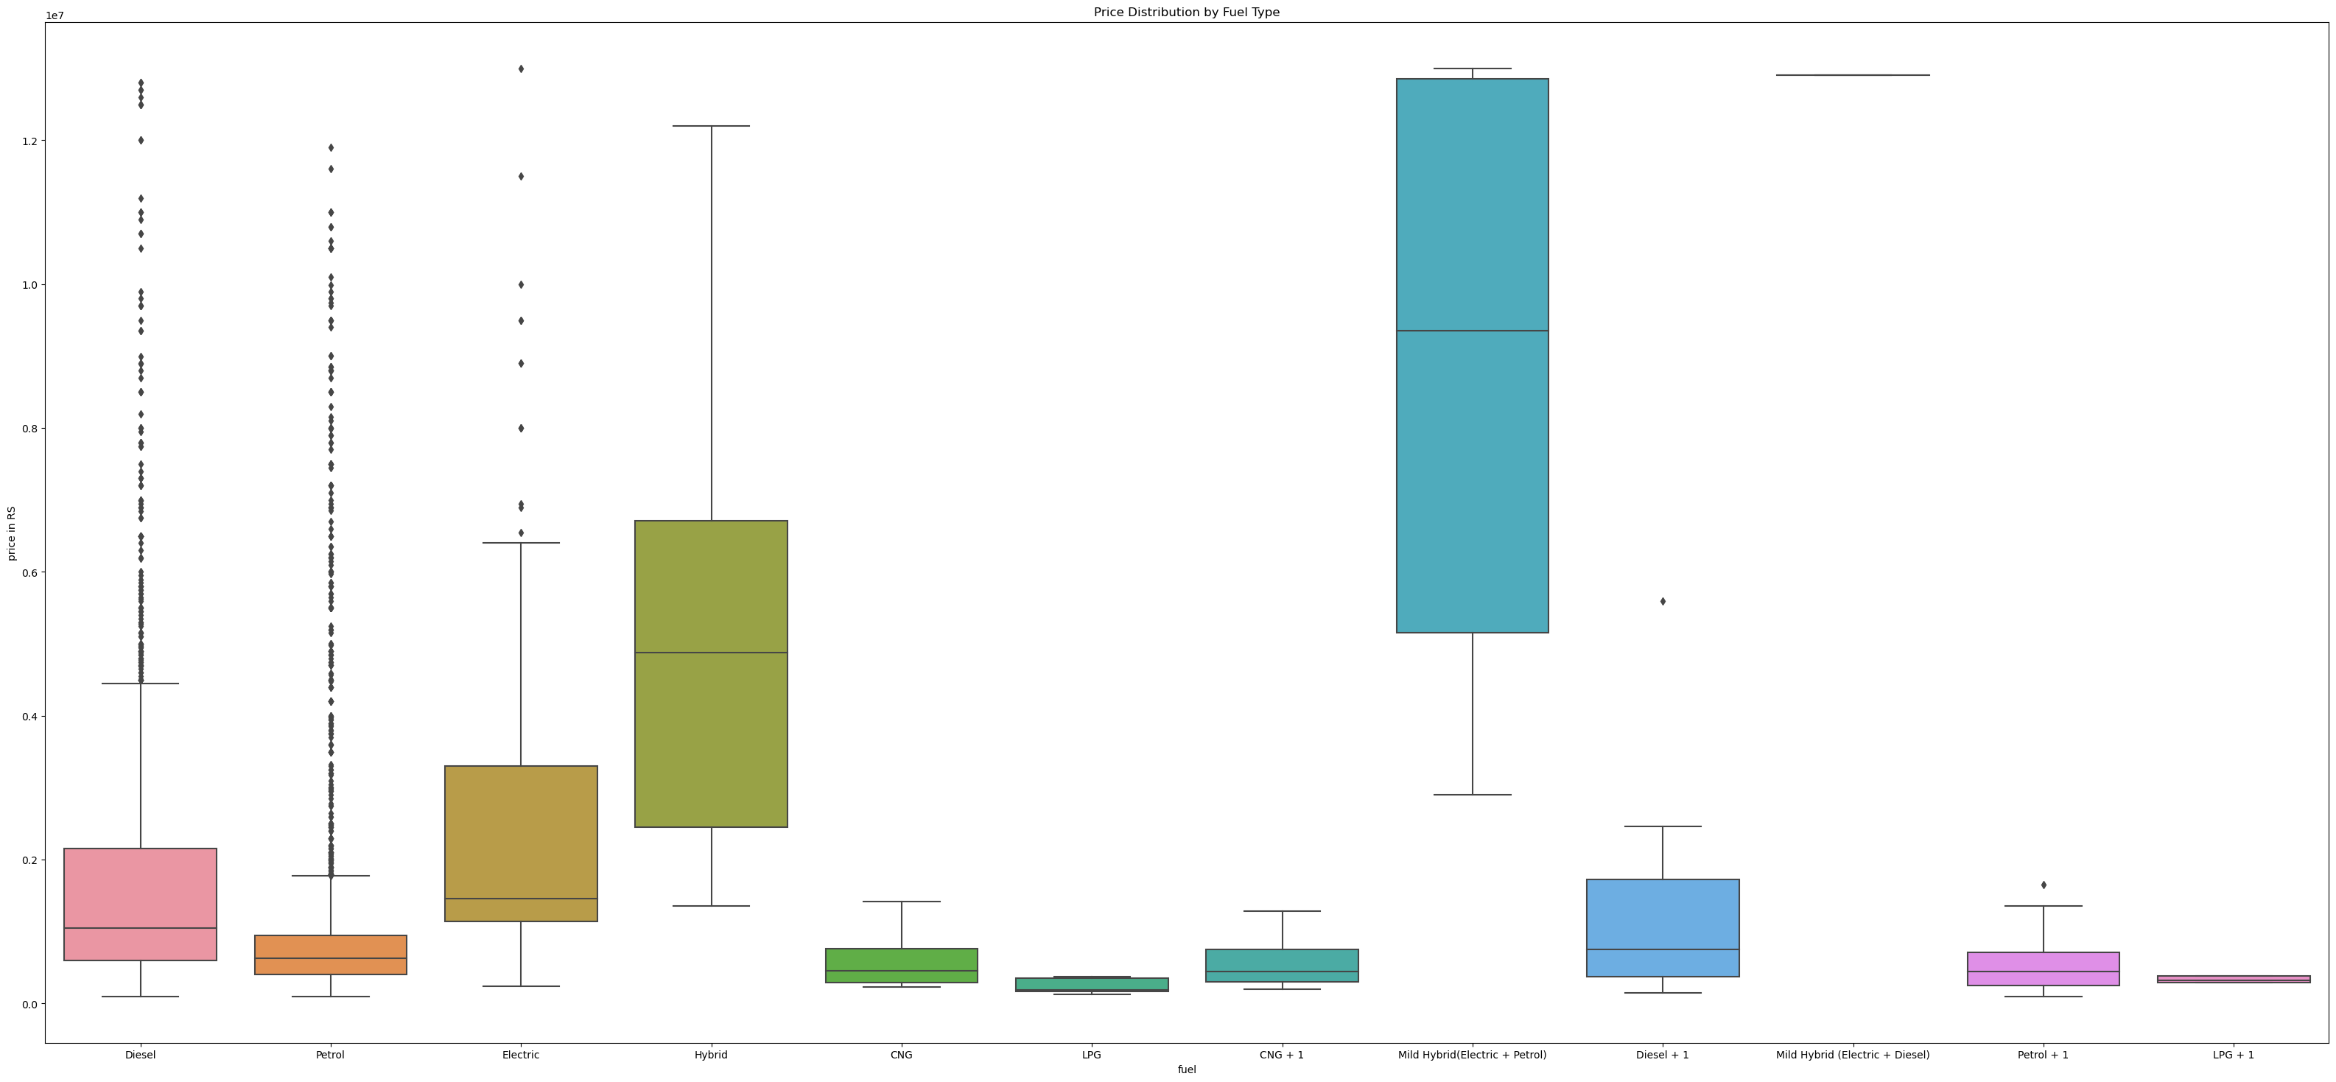
Price Distribution by Fuel Type
ANALYSIS
This graph illustrates the price ranges for different fuel types. Mild Hybrid (Electric + Petrol) vehicles show the highest median price and the widest price range, suggesting they are generally the most expensive. Hybrid vehicles also have a high median price. In contrast, Diesel and Petrol cars have significantly lower median prices, though they exhibit a very wide spread of prices, with many outliers, indicating a diverse range of models within these categories. Other fuel types like CNG, LPG, and their combinations, along with standalone Electric and Mild Hybrid (Electric + Diesel) vehicles, tend to have lower prices and narrower distributions.

Slide 15

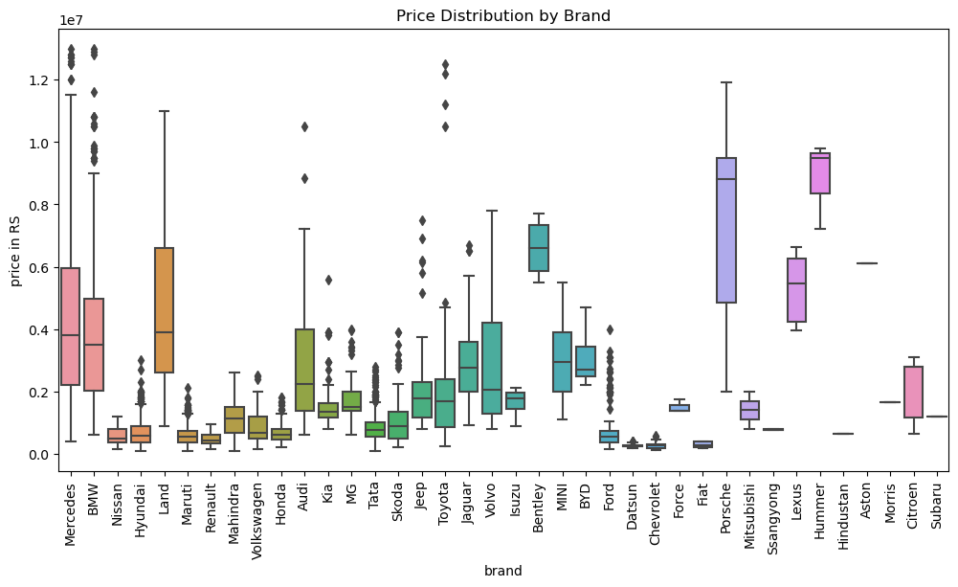
Price Distribution by Brand
ANALYSIS
.
This graph shows that luxury brands like Mercedes, BMW, Porsche, Lexus, Hummer, and Bentley generally have the highest car prices, with some having wide price ranges. Brands like Maruti, Hyundai, and Tata represent the lower end of the price spectrum. Many brands exhibit significant price outliers, indicating the presence of a few very expensive models within their range.

Slide 16
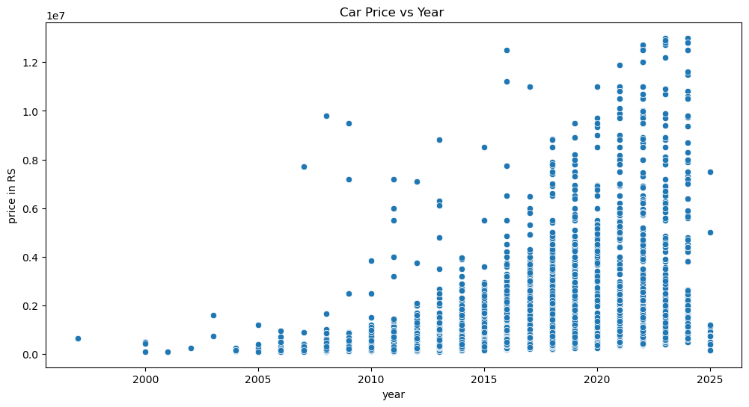
Car Price vs Year
Analysis: This scatter plot shows a general trend of increasing car prices with newer model years, particularly from around 2015 onwards. While there's a wide range of prices for any given year, newer cars (especially from 2018-2023) tend to have more data points at higher price ranges compared to older cars, indicating that more expensive vehicles are being produced or are available in recent years. Older cars generally have lower prices and less variance.

Slide 17
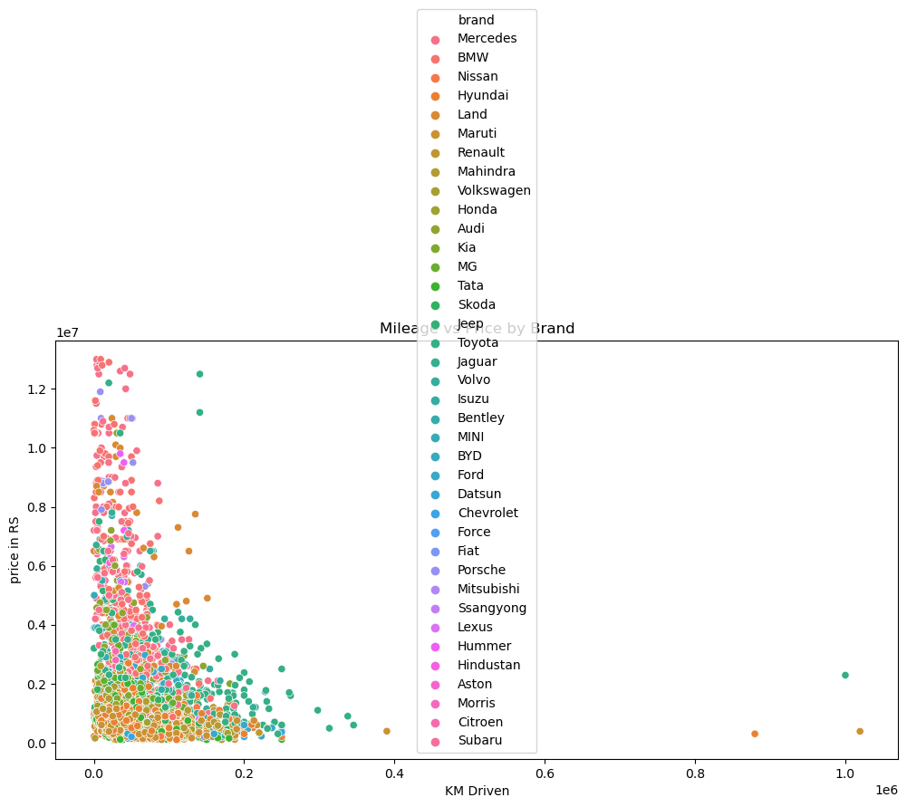
Mileage vs Price by Brand
Analysis: This scatter plot shows that there is generally no strong direct correlation between mileage (KM Driven) and price, as high-priced cars can have both low and high mileage, and vice versa. However, a dense cluster of points at lower mileage suggests that most cars, regardless of price, are sold with relatively low kilometers driven. High-mileage cars (above 400,000 KM) are rare, and tend to be lower in price, with a few notable exceptions that maintain higher values even with extensive use. The color-coding by brand further indicates that premium brands like Mercedes and BMW often command higher prices even with varying mileage.

Slide 18
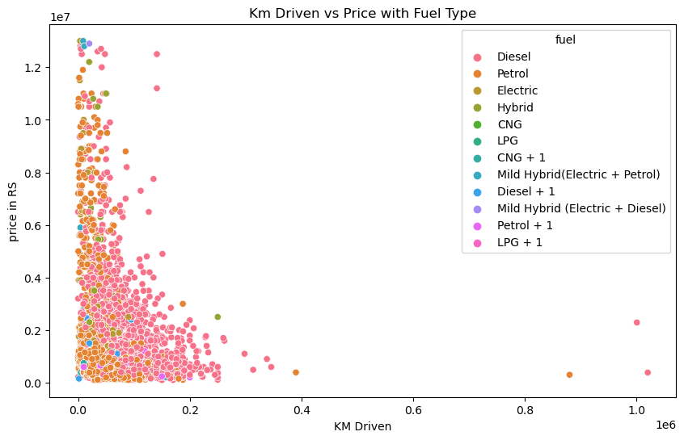
Kilometers Driven vs. Price by Fuel Type
Analysis: This scatter plot demonstrates that for most cars, price tends to be higher at lower kilometers driven, with a general decrease in price as mileage increases. Petrol and Diesel cars form the vast majority of the data points across all price and mileage ranges. While there are some high-priced vehicles at lower mileages (especially Electric and some Hybrid types), the overall trend suggests that extensive usage (high KM Driven) generally leads to lower car prices, regardless of fuel type, though some outliers exist for specific fuel types like Electric and Hybrid that maintain value better.

Slide 19
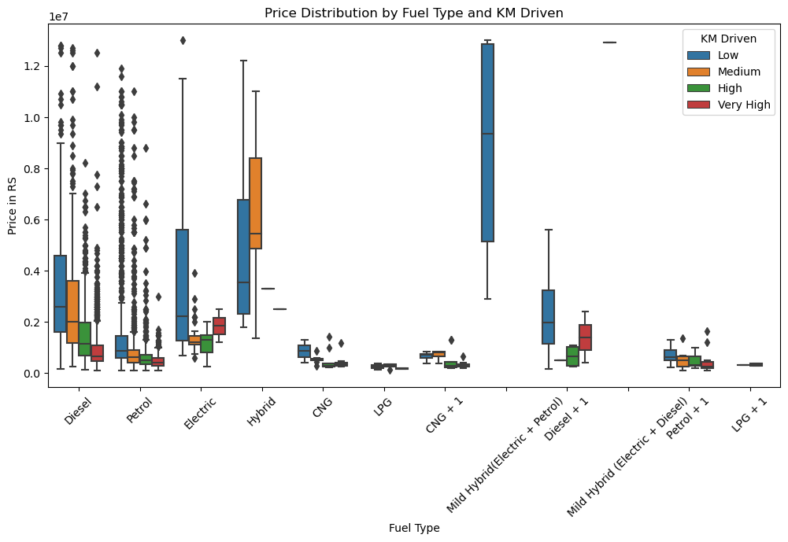
Price Distribution by Fuel Type and KM Driven
Analysis: This graph shows that for most fuel types, cars with "Low" kilometers driven (blue boxes) generally have higher prices and wider price ranges. As the "KM Driven" category increases (Medium, High, Very High), the median price tends to decrease, and the price distributions become narrower. This clearly indicates that lower mileage correlates with higher car prices, regardless of the fuel type, with Mild Hybrid (Electric + Petrol) showing the highest prices overall, especially for low KM driven.

Slide 20
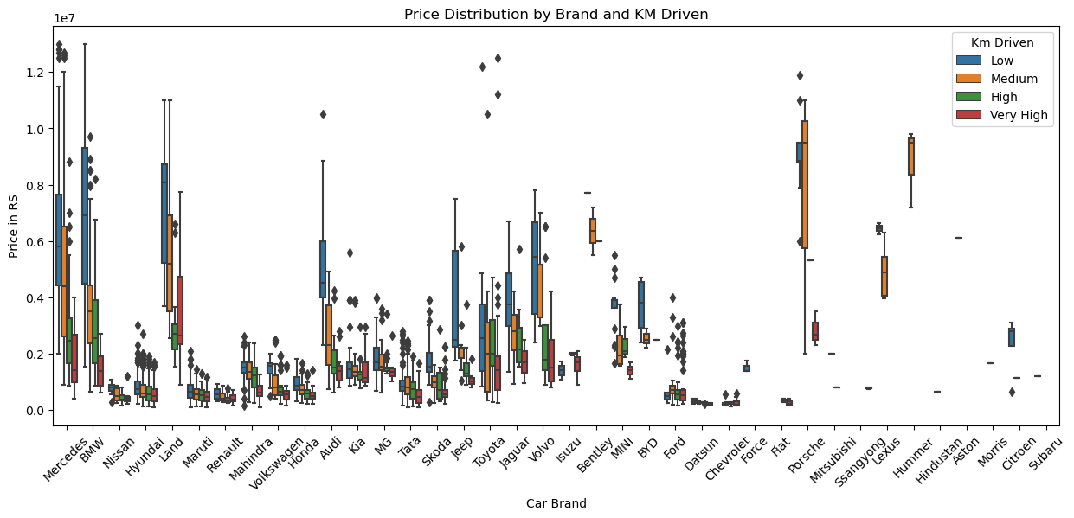
Price Distribution by Brand and Kilometers Driven
Analysis: This graph clearly shows that for nearly all car brands, lower mileage ("Low" KM Driven) is associated with significantly higher prices and often wider price ranges. As the kilometers driven increase ("Medium", "High", "Very High"), the prices generally decrease, and their distributions become narrower. Premium brands like Mercedes and BMW consistently show high prices across mileage categories, while more budget-friendly brands like Maruti and Hyundai remain in lower price tiers regardless of mileage.

Slide 21
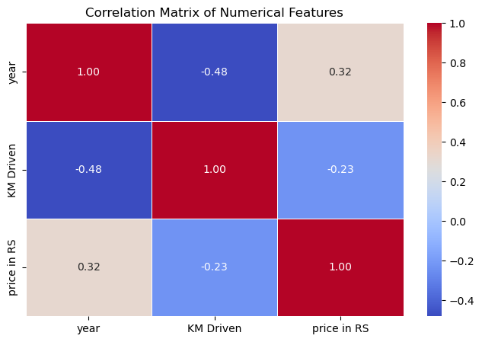
Correlation Matrix of Numerical Features
Analysis: This correlation matrix shows that car price has a positive correlation with the car's year (0.32), meaning newer cars tend to be more expensive. Conversely, car price has a negative correlation with KM Driven (-0.23), indicating that cars with higher mileage are generally cheaper. There's also a moderate negative correlation between year and KM Driven (-0.48), suggesting newer cars typically have fewer kilometers driven.

Slide 22
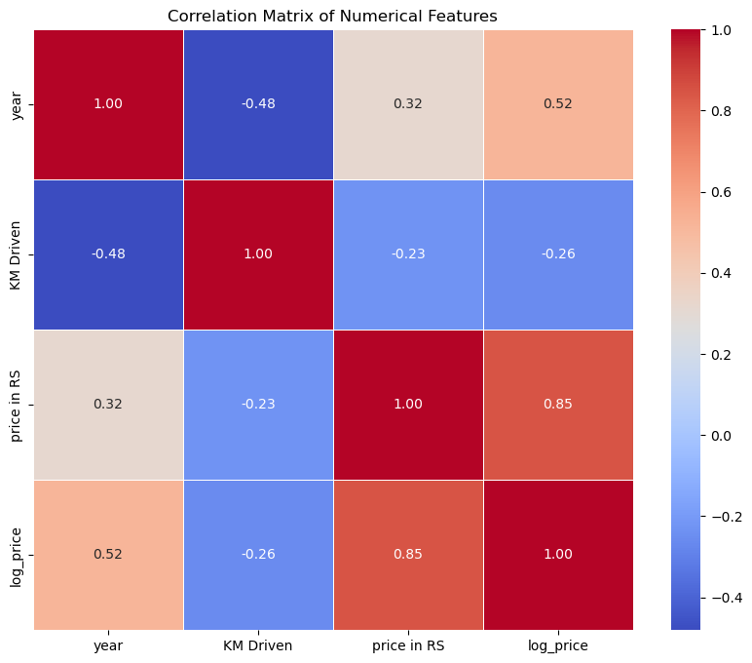
Correlation Matrix of Numerical Features (Extended)
Analysis: This correlation matrix highlights strong relationships between price variables. Both 'price in RS' and its logarithmic transformation 'log_price' have a very strong positive correlation with each other (0.85 and 1.00 respectively, as expected). Newer cars ('year') show a moderate positive correlation with price (0.32) and a stronger one with log_price (0.52), meaning newer cars tend to be more expensive. Conversely, 'KM Driven' has a negative correlation with both price and log_price (-0.23 and -0.26 respectively), indicating that higher mileage generally leads to lower prices. There's also a moderate negative correlation between 'year' and 'KM Driven' (-0.48), suggesting newer cars typically have fewer kilometers driven.

Slide 23
BUSINESS IMPLICATIONS
FOR INVENTORY MANAGEMENT:
Focus on stocking cars in the ₹3–6 lakh range, where demand is highest.
Avoid over-investing in extremely high-priced vehicles due to low demand and slower turnover.
Budget-friendly and mid-range cars are optimal for faster sales cycles.
.
FOR PRICING STRATEGY:
Use log-transformed price insights to identify fair pricing zones and detect overpriced listings.
Outlier removal allows better price prediction models for transparent negotiations.
Dynamic pricing tools can be built for dealers based on distribution patterns.
FOR MARKETING:
Emphasize affordability and value-for-money in ads for budget-range cars.
Highlight popular models and price ranges in campaigns to attract price-sensitive buyers.
Leverage regional trends in pricing to tailor local promotions.
FOR FINANCE & SERVICES:
Promote financing options more aggressively for mid-tier buyers (₹5–10 lakh segment).
Offer bundled insurance/loan deals for cars in the most in-demand price range.
Data-backed insights help design EMI plans suited for actual buyer segments.

Slide 24
CONCLUSION
->The majority of cars are from 2015 to 2021, indicating a preference for newer models with modern features.
-> Maruti, Hyundai, and Honda emerged as the most popular brands due to their affordability, fuel efficiency, and strong after-sales service.
->The price distribution was highly skewed by a small number of luxury listings. After removing outliers and applying a log transformation, clearer pricing patterns were revealed, showing most cars priced between ₹4 to ₹10 lakhs.
->Fuel type analysis showed petrol cars dominate the market, while diesel vehicles maintain competitive resale value. Electric cars are present but remain a small segment, reflecting their emerging status.
->Most vehicles fall within a mileage range of 30,000 to 90,000 km, which aligns with optimal resale periods (3–6 years of usage).->
->Geographically, urban centers list newer, costlier cars, while tier-2 and tier-3 cities lean toward older, budget-friendly options.
->Bivariate analysis showed that fuel type, year, and brand significantly affect vehicle pricing. For example, diesel cars of the same brand and year tend to be priced higher than petrol variants.
->This analysis also emphasizes the importance of removing outliers to prevent skewed business decisions and supports the use of transformation techniques for better model interpretability.
->The insights derived can help buyers make informed purchasing decisions, sellers price their vehicles competitively, and online marketplaces enhance filtering, recommendation systems, and demand forecasting.

Slide 25
CHALLENGES FACED:
->Dynamic Website Structure: Web elements on CarWale changed across pages, requiring adaptive scraping logic.
->Pagination Handling: Navigating through multiple pages and avoiding data duplication was technically demanding.
->IP Blocking & Captchas: Frequent scraping led to request blocking, needing proxy servers, user-agent rotation, and time delays.
->Data Quality Issues: Some records had missing or inconsistent values, especially in year, mileage, and model fields.
->Duplicate Listings: Cars were often listed multiple times across different locations, requiring deduplication.
->Inconsistent Text Formats: Fields like "KM Driven" and "Price in RS" included units and extra symbols that required cleaning.
->Outlier Presence: Extremely high car prices (e.g., luxury brands) skewed results and needed to be removed or transformed.
->Data Type Mismatches: Key columns like "year" and "KM Driven" were initially strings, needing type conversion for analysis.
->Cleaning Unstructured Data: Model names were often embedded with brand or trim-level info, complicating categorization.
->Skewed Distributions: Price and mileage data had long tails, requiring log transformation for accurate visualization.
->Memory Constraints: Processing and visualizing large data subsets slowed down performance on limited-resource machines.
->Standardization Efforts: Multiple name formats for the same brand or location required grouping and normalization.

Slide 26

THANK YOU

